Slide 1
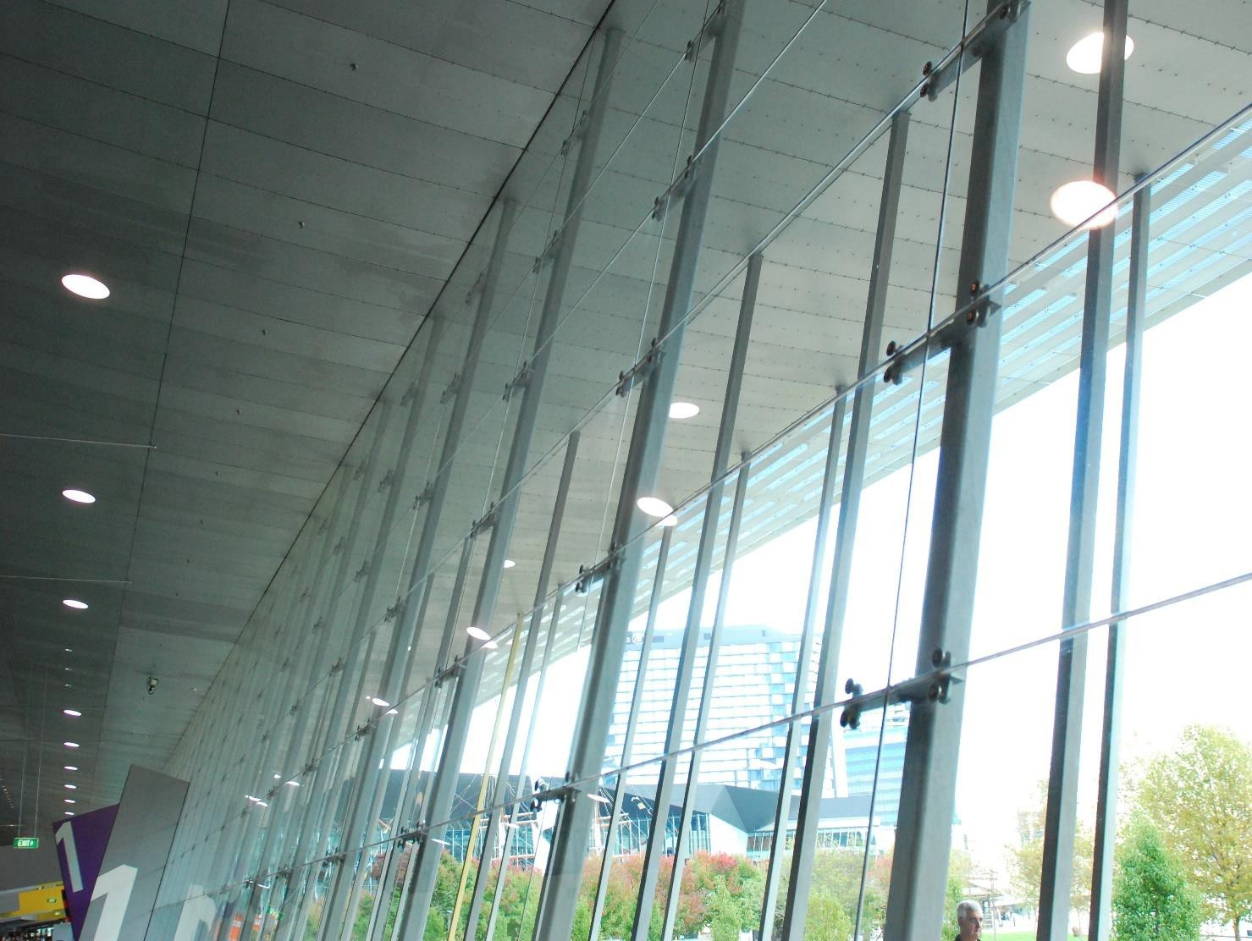
PD 85 KBT Study Guide
AGMT Certification - Written Test

Slide 2
This Study Guide is a publication of the Architectural Glass and Metal Certification Council (AGMCC).
The AGMT Certification Program and the AGMCC assume no liability for personal injury or property damage incurred by any person or organization making use of the material contained herein. Use of the materials is for educational and advisory purposes only.
No part of this publication may be reproduced, stored in a retrieval system, or transmitted, in any form or by any means, electronic, mechanical, photocopying, recording, or otherwise, without prior permission of the publisher.

Slide 3
The AGMT Certified Glazier:
Congratulations on your decision to take the Architectural Glass and Metal Technician (AGMT) Certification Program Test. Those who pass the knowledge and physical based tests, and become certified set themselves apart as individuals whose fundamental knowledge, skills, and abilities have been proven through an independent, 3rd party, ANSI accredited means of evaluation. Those glazing technicians who possess this certification confidently demonstrate to employers that they have a core competency and are ready to contribute safely and meaningfully to the glazing industry. Those who have this certification bring value to any project and organization, and have the skills verification necessary to succeed in this industry.
Purpose of the Study Guide:
This study guide is intended to be used to help focus the study efforts of the test taker. It covers all of the major glazier knowledge categories that will be on the written portion of the test. Sample questions are provided at the end of this document to allow for practice and evaluate the candidate’s level of understanding.
Resources:
Included in the study guide are links to websites and documents that the candidate may find useful. Applicable links are found within each sub-category of the study guide. Material found at these links may only partially cover test materials, or may provide additional information not covered by the test. Many of the links direct candidates to on-line courses that are available for purchase from an unaffiliated (with AGMT), 3rd party organization. It is up to the individual candidate to decide if such courses would be of value. (Note: Links provided within a particular sub-category may also apply to other sub-categories within the study guide.)
The Written Test:
The Knowledge Based Test (KBT), or written test, will be administered in a test center. The test consists of 125 multiple choice questions. Each question has 4 possible answers from which the candidate must select the correct response. Candidates will be given a 2 hour time limit to complete the test.

Slide 4
Contents
Section 1: Testing Skills .................................................................................................................................... 5
Section 2: Test Content.................................................................................................................................... 6
Section 3: Test Categories ............................................................................................................................... 7
A. Glazing Theory ......................................................................................................................................... 7
B. Tools and Equipment of the Trade .......................................................................................................... 9
D. Glass and Panels .................................................................................................................................... 14
E. Systems .................................................................................................................................................. 16 G. Quality Controls / Failure Prevention.................................................................................................... 23
Section 4: Practice Questions for AGMT Written Test Prevention ............................................................... 26 Section 5: Answer Key.................................................................................................................................... 30
Section 6: Resources ...................................................................................................................................... 30
General Glazing Resources: ....................................................................................................................... 30
Video Links: ................................................................................................................................................. 31

Slide 5
Section 1: Testing Skills
Test Preparation:
Don’t Procrastinate/Cram
Make a study plan
Weekly
Monthly
Review with a group
Organize reference materials
Use visual aids
Charts
Outlines
Diagrams
Tables
Get plenty of sleep
Stay healthy and hydrated
Arrive early to testing site
Test-taking Skills:
General test taking strategies:
Be prepared.
Listen attentively to last minute instructions given by the instructor.
Read the test directions very carefully and watch for details.
Make certain your answer has been accurately registered on the computer screen.
Plan how you will use the allotted time.
Answer all the questions.
Skip harder questions and return to them at the completion of each section/test.
Plan to finish early and have time for review.
Look for accidentally skipped questions.
Specific Strategies for computer-based tests
Use scratch paper: Having and using scratch paper will allow you to jot down details, formulas, etc. while you look at other areas of the screen. This will save scrolling time. Scratch paper and pencil will be provided to each candidate.
Watch Your Time: On paper, it’s easy to cycle through questions repeatedly. On screen, it can be slow and awkward. You’ll need more time for cycling.
Practice with a Timer: Practice with the sample questions at the end of this document. To match the pace required for the actual test you should be able to complete the 20 questions in 19 minutes.

Slide 6
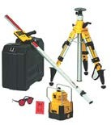
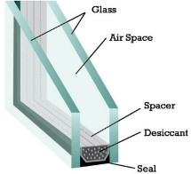
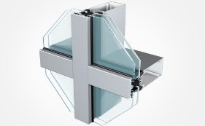
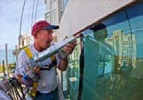
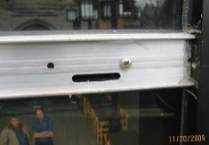
Know the Rules Up Front: Review the scoring system and details about the multiple-choice question format, and how the computer handles it. It’s one less thing to worry about on test day.
Section 2: Test Content
Testing Categories:
The written test is divided into 7 major categories:
Glazing Theory
Tools & Equipment
Documents & Layout
Glass & Panels
Systems
Sealants & Gaskets, etc.
QC & Failure Prevention
Sub-categories:
Each test category is further divided into between 3 and 6 sub-categories, for a total of 28. On the following pages the sub-categories are identified.
To assist the candidate in preparing for the written exam, the general knowledge and skills requirements of an experienced glazier are provided for each sub-category, along with additional requirement descriptions, where applicable. The written test questions have been drawn from these general requirements.

Slide 7
Section 3: Test Categories
A. Glazing Theory
Applied Glazing Related Math
General requirements:
Possess basic mathematical skills required to effectively perform day-to-day fundamental glazing measurements, layouts, and calculations.
Ability to work with both metric and imperial measurements
Use basic glazing related geometry
Add, subtract, multiply, and divide whole numbers and fractions, and convert fractions to decimal equivalents, feet to inches, and metric conversions.

Slide 8
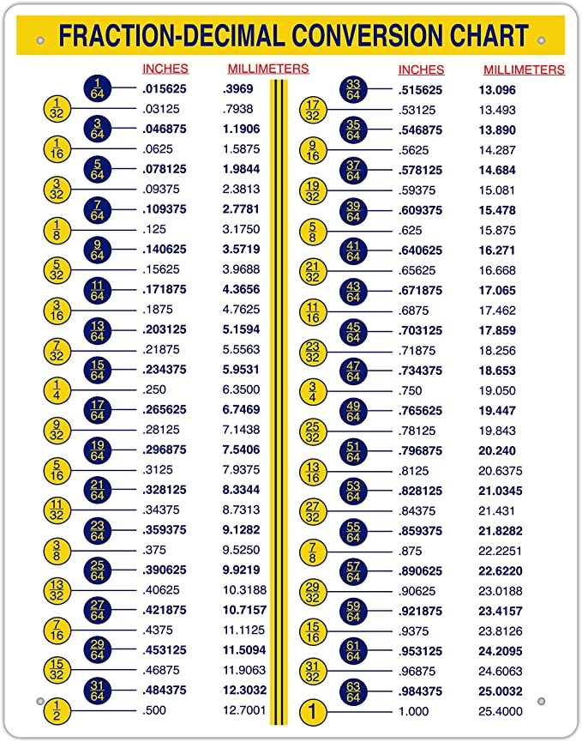

Slide 9
BASIC GEOMETRIC FORMULAS AND PROPERTIES
This handout is intended as a review of basic geometric formulas and properties. For further or more advanced geometric formulas and properties, consult with a SLAC counselor.
S
Square:
Perimeter: P = 4s or 2s + 2s
Area: A = s'
Rectangle:
Perimeter: P — 2w + 2f
Area: A = / x w
Triangles:
Perimeter: P = a + b + c Area: A = (1/2) x b x h
Types of Triangles:
Isosceles (two equal sides) Equilateral (all sides equal) Right (one 90° or right angle)
Pythagorean Theorem (for right triangles only):
a' + b' = c'
Sum of the Angles (all triangles):
A + B + C = 180°
Circle:
Diameter: d = 2r Circumference: C = 2 v r= v d
Area: A = vr
Rectangular Solid:
Volume: V = / x w x h
Surface Area: s - (2 x h x w) + (2 x 1 x h ) + (2 x / x w)
Right Circular Cylinder:
Volume: V = v r'h
Surface Area: s = 2 v r h + 2 vr
h
Complementary Angles:
Two angles are complementary
if the sum of their measures
is 90°. Angles A and B are complementary angles. Angles A and C are complementary angles.

Slide 10
Terminology/Communication Skills
General Requirements:
Understand and communicate effectively using appropriate glazing terminology.
General Construction, and glazing specific terminology
Listening and reading comprehension

Slide 11
Glazing Specific Safety
General Requirements:
Have a general working knowledge of glazing-specific safety precautions required when working around and with glazing materials (glass, aluminum extrusions, unitized walls, chemicals, etc.).
Safely handle, move, lift, and maneuver glazing materials (glass, aluminum extrusions, panels, sheet metal and cladding, etc.)
Inspect glass/panels and frames for potential hazards
Bracing and securing glazing materials while stored, being maneuvered, or in transit
A Few Common Safety Precautions:
Always wear safety glasses with side shields and gloves when moving or handling glass.
Inspect the glass before moving it to assure there isn’t any damage that may cause
spontaneous glass breakage.
Use proper lifting and moving techniques. Hold the glass firmly in your
hands. Do NOT carry it over your head or under your arms.
Do not let any surface bump or hit the glass’ edges or corners.
When setting glass on the floor, or other any other surface, gently place it
down on the long edge.
Do not place glass directly on hard surfaces. Instead, use padding, or another type of cushioning agent.
Wrap or cover glass in blankets, or other cushioning agents, to protect it against incidental bumps that could cause chips or scratches.
Carry only one piece of glass at a time.

Slide 12
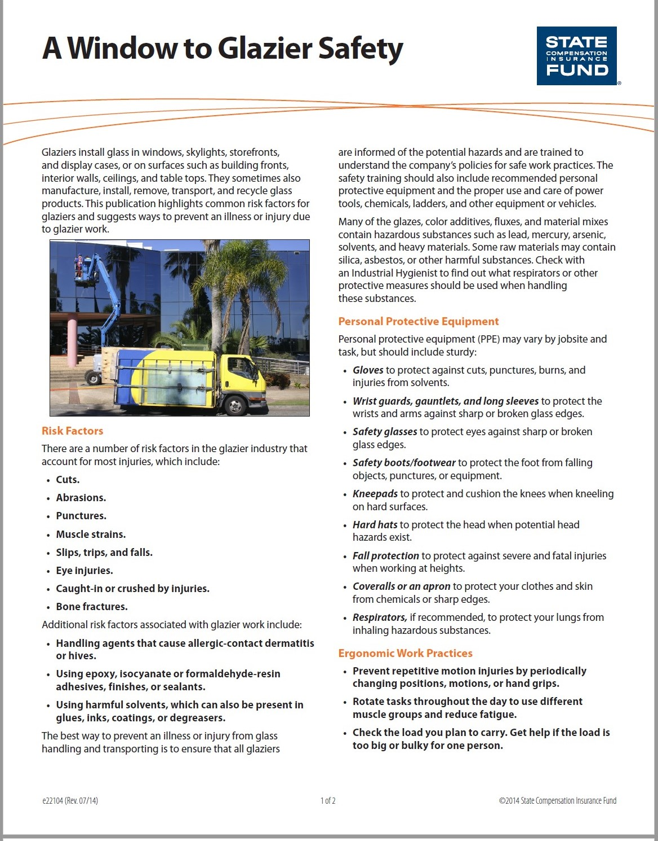

Slide 13
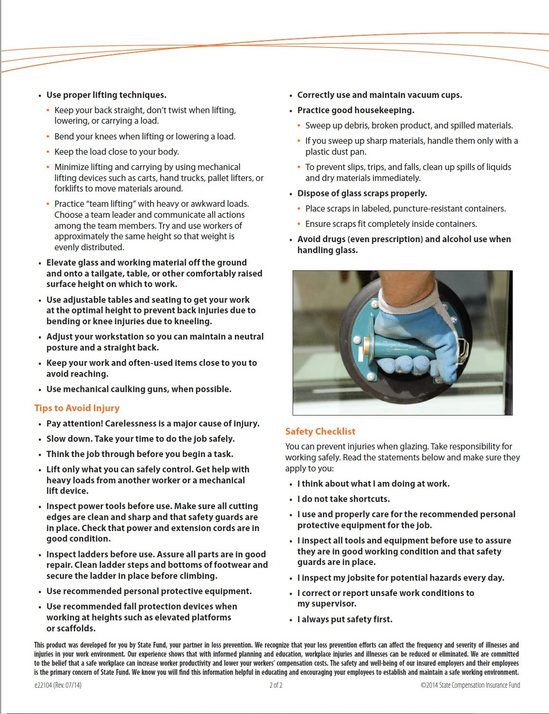

Slide 14
B. Tools and Equipment of the Trade
Hand Tools
General Requirements:
Identify commonly used glaziers’ tools and their uses, and select the appropriate hand tools for specific tasks, and use safely and effectively.
Selecting the right tool for the job
Care, maintenance, storage, and inspection of hand tools
How to store and secure tools at height
Common hand tools for the glazier include but are not limited to:
Measuring Tools: Rules, Straight Edges, Squares
Glass Cutting Tools: Strip cutter, dry glass cutter
Glass Breaking Tools: plate pliers, breaking pliers
Sealant Applicators: Caulk guns, Putty knife
Utility Knives

Slide 15
Glass Handling Equipment
General Requirements:
Selection of appropriate glass handling equipment (i.e. vacuum glass hoists, suction cups, A-frame carts, spider-lifts, etc.) and their effective and safe use.
Glass prep, positioning and securing
Protecting glass edges and surfaces
Understanding capacity and limitations
Portable Power Tools
General Requirements:
Identify commonly used glaziers’ power tools and be familiar with their uses and selection of appropriate power tools for specific tasks; and use the tools safely and effectively.
Selecting the right tool for the job
Inspection of the cord, grounding, housing
How to use, store, and secure at height
Some examples of Power Tools:
Jig Saws
Belt Sanders
Dust Extractor
E-cut Blade
Mushroom Blade
Drills and drivers
Powder actuated fasteners

Slide 16
Scaffolding and Personal Lifts
General Requirements:
Appropriate selection of, and knowledge/ability to work from elevated work platforms (i.e. scaffolding, personal lifts); and correct placement and assembly (where applicable) of equipment and components.
Load limitations and correct applications
Consideration for terrain and base surfaces, plus barriers
Inspect for damage and unsafe conditions
Bits, Tips, Taps
General Requirements:
Proper selection and uses of bits, tips, and taps, and their effective and safe use.
Identification of types and sizes
Select right one for the job
Proper inspection practices and processes
Rigging and Hoisting
General Requirements:
Use of appropriate rigging, hoisting, tag lines and signaling to manipulate (or facilitate movement of) materials on the job site in a safe and effective manner.
Identify components of rigging that encounter glazing materials
Selection of proper rigging based upon size and capacity of materials being lifted
Securing perimeter and pre-task path planning

Slide 17
C. Construction Documents and Layout
Project Drawings and Document Review
General Requirements:
Utilize construction documents to determine correct materials, components, systems, quantity, size, fit, opening conditions, and locations of glazing systems.
Understand different views of drawings (i.e. plans, sections, elevations, details,
symbols gridlines); and how to maneuver from one view to another within the same opening
Determine appropriate materials, quantities, lengths, sizes from construction and shop documents, and locate accurately
Identify glazing related materials from those of other trades
Basics of Layout
General requirements:
Ability to use math, appropriate contract documents, tools and layout principles to accurately locate framing members (plumb, level, and square). Determine from blueprints and contract documents location of control lines and reference points as they relate to scope of glazier’s work.
Ability to evaluate site conditions as compared to contract documents
Determine plumb, level, and square, and apply to benchmark/reference points; and understanding tolerances
Proper selection and use of layout tools (i.e. tape measure, level, laser, etc.).
Plumb: Plumb is defined as true to a vertical plane. A correctly plumbed object such as a support column takes maximum advantage of gravity, transferring loads directly to the ground.
Level: Level is defined as true to a horizontal plane.
Square: Square is when a plumbed object intersects with a level object, they create a 90-degree angle.

Slide 18
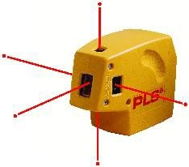
3. Measurement and Layout Equipment
General requirements:
Proper use of measurement and layout equipment, including care,
maintenance, calibration, storage, and handling. Must be able to verify accuracy and demonstrate proper setup, conversion and location of control points.
Common Measurement and Layout Equipment:
Tape Measure | •Carpenter Pencil | Protractor
Speed Square | Laser Measure | •Scriber
D. Glass and Panels
Proper Installation
General requirements:
Select and use necessary tools and equipment, handling and installation procedures for proper placement of system’s components to receive glass, in proper sequence. Install glass in proper sequence with attention to edges and surface to prevent damage and maintain glass integrity as relates to strength and aesthetics; maintaining prescribed edge coverage and sightlines. Install glass retaining devices (i.e. pressure plates, snap-in channels, gaskets, etc.) as per manufacturer’s installation instructions avoiding too little or too much edge pressure on glass.
Install glass properly oriented (e.g. outboard/inboard lite, left-hand/right-hand, up/down, logo location)
Proper selection and placement of setting/edge blocks
Properly prepare channels to receive glass or panels, and keep weep holes and water paths unobstructed

Slide 19
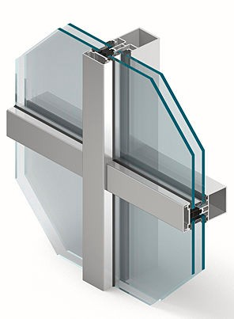
Storage and Handling
General requirements:
Properly protect materials (and personnel) throughout all aspects of warehousing, staging, storage, and movement of materials, taking into consideration surroundings and environment.
Proper tool and equipment selection and procedures for transporting, handling, and moving
Inspection practices and processes
Selection of storage location and protection from elemen
Insulating Glass Units (IGU) ( A.K.A. Double-glazed units)
General requirements:
Properly handle IGU to protect from potential shearing effect, or surface, edge or
seal damage; understand the potential for detrimental effects from the use of incompatible glazing sealants, gaskets, and setting/centering blocks, always using specified materials.
Understand causes and how to prevent shear stress, always providing equal support of both lites of an IGU
IG Compatibility with glazing sealant, setting/centering blocks, gaskets
Determine proper surface orientation (1,2,3,4)
E. Systems
Framing Basics
General Requirements:
Utilize shop drawings and construction documents to select, fabricate, assemble, and install components of fenestration framing as per manufacturer’s fabrication/assembly/installationinstructions.
Proper location and application of sealants at substrate interfaces
Select appropriate anchors and fasteners, properly locating frame to benchmarks, installing plumb, level, and square.
Properly sequence material and component installation

Slide 20
Fasteners and Anchors
General Requirements:
Properly select and install fasteners, anchors, shims and spacers in the correct location with proper frequency, with consideration for the opening substrate; using correct hole sizes for both anchors and fasteners.
Identify types and correct uses of fasteners, anchors, shims and spacers understanding their compatibility with substrates and materials
Use of correct hole sizes for anchors (in substrate) and fasteners (in frames), and use of shims where applicable
Storefront / Window Wall General Knowledge
General Requirements:
Possess an understanding of the types and typical uses and applications and limitations of storefront and window wall systems; their similarities and differences; and how they differ from curtainwalls. Familiarity with their components and assembly sequence and methods, and a working knowledge of their water management elements.
Types of storefronts/Window walls and typical applications, including limitations
Sequence of installation and glazing methods
System makeup; and interchangeability of components
Window wall systems are commonly used in ribbon window configurations or punched openings. The framing system spans from slab-to-slab and can be installed from the building's interior to improve logistics and reduce installation costs.
A storefront is the facade or entryway of a retail store located on the ground floor or street level of a commercial building, typically including one or more display windows.

Slide 21
Curtainwall General Knowledge
General Requirements:
Possess an understanding of curtainwall materials, their uses, general features and benefits; their differences from storefront and window wall systems; and assembly
methods, as well as their water management elements; understand the different
types of curtainwalls (stick, unitized), and their sequence of installation and glazing methods.
Principles of the different types of curtainwalls (stick, unitized), and their sequence of installation and glazing methods
Transition and expansion joints; deadload/windload anchors
Recognition of torque specifications and the effects of not adhering to them (over/under)
A "curtainwall" is any non-load-bearing exterior wall that hangs (like a curtain) from the face of floor slabs, regardless of construction or cladding material. However, in common usage, the term curtainwall usually refers to aluminum-framed systems carrying glass, panels, louvers, or occasionally, granite or marble.
Aluminum Entrances General Knowledge
General Requirements:
Possess an understanding of the various types of aluminum entrance doors, their components and assembly, door frame materials, and various door hardware including pivots, hinges, pulls and locking devices. Have ability to fabricate,
assemble and install framing and hang door in opening and perform typical adjustments. Understand general ADA and safety glazing requirements.
ADA knowledge and safety glazing requirements
Sequence of installation (relative to itself and to surrounding glazing materials) and coordination and interface w/ adjacent glazing systems
Tolerances/clearances

Slide 22
F. Sealants and Gaskets / Ancillary Materials
1. Joint Prep, Weather Seal, and Internal Sealing
General Requirements:
A detailed understanding of the need for, and uses of wet sealants to control and
prevent water and air infiltration. A clear understanding of where wet sealants are needed, how to verify proper locations using manufacturer’s instructions, proper cleaning and preparation, application and tooling of sealants; with consideration for potential material compatibility issues.
Cleaning methods and primer selection and application
Knowledge, selection, and insertion of backer rods and sealant application and tooling
Principles of material compatibility and importance of only using specified materials
There are five basic steps for proper joint preparation and sealant application:
Clean – Joint surfaces must be clean, dry, dust free, and frost free.
Prime – If required, primer is applied to the clean surface(s)
Pack – Backer rod or bond breaker as required.
Shoot – Sealant is applied by “pushing the bead” into the joint cavity.
Tool - Dry tooling techniques are used to strike a flush joint and make certain the sealant has the proper configuration and fully contacts the joint walls.

Slide 23
2. Setting/Edge Blocks
General Requirements:
Proper selection and placement of setting and edge blocks in relation to glass and framing components, and consideration for water management functionality of
the system. Understanding material compatibility concerns and the importance of
only using specified material, or selecting proper material (in the absence of a specification).
Compatibility issues and cautions
Selecting proper size and determining location of setting and edge blocks
Setting blocks are typically used as cushions between glass and aluminum in architectural systems. Blocks come in many thicknesses, widths and lengths as well as many different polymers. They can be extruded or fabricated to any length required. A pressure sensitive adhesive (PSA-1) can also be added to these materials.
Each lite of glass should be set on two setting blocks centered approximately at the bottom edge quarter points. When this is impractical, the end of the setting block can be moved within either 6” (152mm) or 1/8 the width of the glass from the vertical edge, whichever distance is greater. Blocks should always be an equal distance from the center of the glass and should be of a material with a Shore A durometer hardness of 85 ± 5 e.g. neoprene, EPDM or silicone. In a metal glazing system, the length of each setting block should be 0.1” for each square foot (27 mm per square meter) of glass area, but not less than 4” (100 mm). All setting blocks should be of sufficient height to provide the minimum edge clearance for the type of glass being glazed and for the nominal bite
recommended. Setting blocks should be 1/16” (2 mm) less than full channel width or positively located in the channel so they cannot be misaligned during glazing. If setting block shims are required, they must be located under the setting blocks and have a durometer rating equal to or greater than that of the setting blocks.
Dry Glazing (Gaskets)
General Requirements:
Proper selection, sizing, and installation and sealing of gaskets in glazing systems, both interior and exterior; proper sizing, cutting, and sequence of installation; types, uses and purposes of gaskets.
Using sealants with gaskets
Dry Glazing is the installation of glass using extruded gaskets in PVC, EPDM or Santoprene to one or both sides of the glass to provide a compressed weather seal. No sealants or putties are present in this system and the windows are designed to be self-draining.

Slide 24
Installation of gaskets commences from the corner of a frame and they are inserted under pressure to form a tight compressed weather seal. Gaskets should be cut over- size to allow for shrinkage and to assist with installation they can be lubricated and softened by immersion in hot soapy water.
Advantages:
Allows interior glazing
Less dependent on workmanship and weather
Less costly than wet glazing
Disadvantages:
Not as water resistant
Gaskets can shrink which can create openings for water penetration
Gaskets can roll into pocket and place uneven stress on glass.
Gaskets can allow glass to move
Wet Glazing (Structural Glazing)
General Requirements:
Possess knowledge and ability to apply gunable “wet” sealant for structural purposes, in shop and field environments, using appropriate means and as per silicone and system’s installation instructions, using proper application and tooling of sealant.
Follow sealant manufacturer installation instructions
Proper application and tooling of structural sealants
Read and interpret specifications, drawings and systems’ installation instructions
Structural Glazing is a method of bonding glass to a building’s structural framing members utilizing high strength silicone.
Advantages:
Increases the thermal efficiency of buildings, because the exterior exposure of metal framing is either reduced or eliminated
Reduces or eliminates water and air infiltration
Reduces the potential for thermal breakage of glass
Help to reduce glass movements
Disadvantages (in curtainwall fabrication and installation):
Requires exterior access for installation, maintenance and glass removal
High workmanship
Cost more than dry glazing

Slide 25
G. Quality Controls / Failure Prevention
Water Management/Drainage Systems
General Requirements:
Possess a fundamental working knowledge of the principles of water infiltration, accumulation, and drainage for various types of glazing systems, and how attention and inattention to proper routine glazing processes may affect them. Understand how various systems manage water infiltration.
Correctly install water management components (e.g. deflector, end dams, joint plugs, setting blocks)
Proper application and tooling of internal sealants at designated locations per instructions
Proper location, placement, size, and shape of weep holes
Glazing sealants cannot exclude all water, so providing internal drainage is critical. The water resistance/weatherproofing performance of a glazing system depends on the following:
Details of the framing system that promote drainage
internal framing seals
external (i.e. glass-to-frame) seals
Material Compatibility
General Requirements:
Possess a working knowledge of issues that might arise from the use of glazing materials that are incompatible with other glazing components, and the importance of using only specified or tested materials; no field substitutions. Have knowledge of all materials that might pose an incompatibility threat to a system,
including the potential for issues arising from dissimilar materials in contact with each other, as well as the potential for deleterious effects on glass and metal coatings, and structural adhesives.
Know the detrimental effects of using incompatible glazing materials, cleaners, primers, sealants, blocks, and gaskets; and their potential effect on IGU’s, glass coatings, and metal coatings.
Know which materials have the potential for incompatibility issues
Select and use only specified glazing materials

Slide 26
Interfaces
General Requirements:
Identify interfaces and the potential for leaks, expansion/contraction, aesthetic issues, as well as chemical reaction between dissimilar materials – utilizing a basic working knowledge of the principles of water infiltration, accumulation, and drainage.
Proper installation of glazing products in relation to material from other trades
Ability to select and install correct sealing materials for interface joints
Understanding the importance of tolerances
Inspections
General Requirements:
Visually review and/or mechanically test completed steps to ensure proper conformance to installation instructions, construction documents, and/or other benchmarks; including opening substrates (as completed by other trades).
Properly identify/document inspected areas
identify / Isolate non-conforming work when there are problems (i.e. tagging/marking)
Verify proper function of operable components (i.e. doors, windows, vents)
Verification of materials proper use within manufacturers guidelines (e.g. proper torqueing, temperature range, expiration dates, surface protection, etc.)
Inspections of Glazing System
Window and door installation quality
Conservatory installation quality
Material Quality
Visual quality of glazing
Insulating Glass Units with Seal Failure
Spontaneous and other breakage types
Inclusion Analysis
Condensation and ventilation issues
Sealant incompatibility
Design calculations
Water ingress and Drainage investigations
Safety, security and thermal (Glass type and function analysis)

Slide 27
PRACTICE TEST

Slide 28
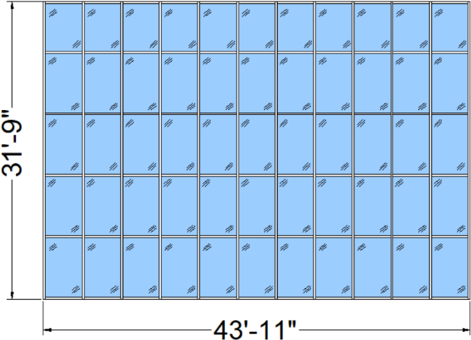
Following are examples of the type of questions that might be found on the written AGMT test:
1. A curtainwall opening measures 43’ -11” along its width and 31’ -9” in height. What is the perimeter of its opening?
a. 149’-8”
b. 75’-8”
c. 151’-4”
d. 150’-8”

Slide 29
Following are examples of the type of questions that might be found on the written AGMT test:
1. A curtainwall opening measures 43’ -11” along its width and 31’ -9” in height. What is the perimeter of its opening?
a. 149’-8”
b. 75’-8”
c. 151’-4”
d. 150’-8”

Slide 30
What is a meant by “deflection?”
The angle at which light is reflected by a glass surface
The amount of bending movement of a structural member
The specified pressure a product is designed to withstand
The tendency to scatter or disperse a direct beam of light

Slide 31
What is a meant by “deflection?”
The angle at which light is reflected by a glass surface
The amount of bending movement of a structural member
The specified pressure a product is designed to withstand
The tendency to scatter or disperse a direct beam of light

Slide 32
3.The ability of a sealant to stick to a surface is the definition of:
Adhesion
Shear Strength
Elasticity
Cohesion

Slide 33
3.The ability of a sealant to stick to a surface is the definition of:
Adhesion
Shear Strength
Elasticity
Cohesion

Slide 34
4.Which of the following is MOST important when considering using a heavy, all glass door in a storefront system?
Locking device
Size of door pulls
Pivot and closer
Door stops

Slide 35
4.Which of the following is MOST important when considering using a heavy, all glass door in a storefront system?
Locking device
Size of door pulls
Pivot and closer
Door stops

Slide 36
5.Where should slings be placed when lifting glass overhead?
On the side of cases
On the sides under cleats
Underneath at 1/3 points
Underneath at ¼ points

Slide 37
5.Where should slings be placed when lifting glass overhead?
On the side of cases
On the sides under cleats
Underneath at 1/3 points
Underneath at ¼ points

Slide 38
What is the first step before changing a unit in a pressure bar curtainwall?
Remove cover caps
Cut away the caulking
Remove the vinyl gasket
Remove the fastening screws

Slide 39
What is the first step before changing a unit in a pressure bar curtainwall?
Remove cover caps
Cut away the caulking
Remove the vinyl gasket
Remove the fastening screws

Slide 40
7.Which one of the following documents has the final say concerning the performance characteristics of glass required for a particular opening?
Specifications
Architectural drawings
Building code
Shop drawings

Slide 41
7.Which one of the following documents has the final say concerning the performance characteristics of glass required for a particular opening?
Specifications
Architectural drawings
Building code
Shop drawings

Slide 42
8.Which type of glass is best suited for use in a balcony?
Annealed
Laminated
Tempered
Wire

Slide 43
8.Which type of glass is best suited for use in a balcony?
Annealed
Laminated
Tempered
Wire

Slide 44
9.When glazing a lite of ¾” glass measuring 168 wide, where should the setting blocks be placed?
Closer to the corner than typical
Closer to the center than typical
At typical ¼ points
¼ points plus an additional block in the center

Slide 45
9.When glazing a lite of ¾” glass measuring 168 wide, where should the setting blocks be placed?
Closer to the corner than typical
Closer to the center than typical
At typical ¼ points
¼ points plus an additional block in the center

Slide 46
10.Which of the following is not an advantages of dry glazing?
Can be done from the interior
Less costly than wet glazing
Is less dependent on workmanship and weather
Is more watertight

Slide 47
10.Which of the following is not an advantages of dry glazing?
Can be done from the interior
Less costly than wet glazing
Is less dependent on workmanship and weather
Is more watertight

Slide 48
11.Find dimension “x”:
a. .862
b. .19
c.1.89
d. 3.29

Slide 49
11.Find dimension “x”:
a. .862
b. .19
c.1.89
d. 3.29

Slide 50
In describing the makeup of an IG unit, which glass surfaces is the spacer adhered to?
#1 and #3
# 1 and # 4
# 2 and # 4
# 2 and # 3

Slide 51
In describing the makeup of an IG unit, which glass surfaces is the spacer adhered to?
#1 and #3
# 1 and # 4
# 2 and # 4
# 2 and # 3

Slide 52
13.Which of the following types of systems are installed between floor slabs on upper floors?
Unitized curtainwall
Window wall
Stick-built curtainwall
Storefront

Slide 53
13.Which of the following types of systems are installed between floor slabs on upper floors?
Unitized curtainwall
Window wall
Stick-built curtainwall
Storefront

Slide 54
14.Weep holes are designed for what primary reason?
Equalize air pressure between the exterior and interior of a building
Allow interior air pressure to escape a building while preventing water from entering
Allow water that has infiltrated a curtainwall system a place to escape
Equalize curtainwall temperature to minimize condensation

Slide 55
14.Weep holes are designed for what primary reason?
Equalize air pressure between the exterior and interior of a building
Allow interior air pressure to escape a building while preventing water from entering
Allow water that has infiltrated a curtainwall system a place to escape
Equalize curtainwall temperature to minimize condensation

Slide 56
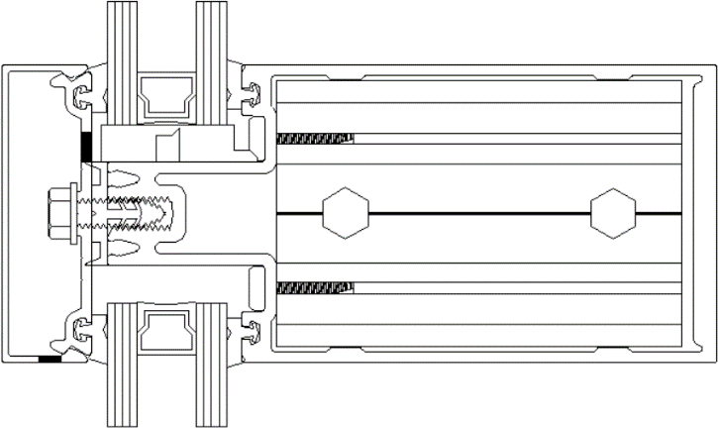
15.What type of curtainwall system is depicted in the detail below?
Structurally glazed
Pressure bar
Point support
Interior glazed

Slide 57
15.What type of curtainwall system is depicted in the detail below?
Structurally glazed
Pressure bar
Point support
Interior glazed

Slide 58
What is the mechanism called that is attached to the end of a lock cylinder plug and is used to actuate the bolt as the key is turned?
Cylinder stop
Compression ring
Cam
Strike

Slide 59
What is the mechanism called that is attached to the end of a lock cylinder plug and is used to actuate the bolt as the key is turned?
Cylinder stop
Compression ring
Cam
Strike

Slide 60
What are vertical door members called?
Rails
Stiles
Flush panels
Pivot receptors

Slide 61
What are vertical door members called?
Rails
Stiles
Flush panels
Pivot receptors

Slide 62
18.Which of the following has removable stops to allow for glass installation?
Intermediate horizontals
Vertical mullions
Corner member
Door jamb

Slide 63
18.Which of the following has removable stops to allow for glass installation?
Intermediate horizontals
Vertical mullions
Corner member
Door jamb

Slide 64
19.Which type of architectural drawing shows the exterior of a building as typically viewed by a person?
Elevation
Plan
Section
Detail

Slide 65
19.Which type of architectural drawing shows the exterior of a building as typically viewed by a person?
Elevation
Plan
Section
Detail

Slide 66
20.When determining if a bubble level is accurate, first take a reading, and then perform which of the following?
Turn the level 45 degrees and compare the two readings
Turn the level 90 degrees and compare the two readings
Turn the level 180 degrees and compare the two readings
Flip the level over and compare the two readings

Slide 67
20.When determining if a bubble level is accurate, first take a reading, and then perform which of the following?
Turn the level 45 degrees and compare the two readings
Turn the level 90 degrees and compare the two readings
Turn the level 180 degrees and compare the two readings
Flip the level over and compare the two readings

Slide 68
Section 5: Answer Key
C
B
A
C
D
A
C
B
A
D
A
D
B
C
B
C
B
A
A
C
Section 6: Resources
General Glazing Resources:
NGA/Glass Association of North America: Association Website
www.glasswebsite.com
National Glass Association: Association Website
https://www.glass.org/
NGA/GANA: Glass Information Bulletins
http://www.glassdocs.com/
NGA: MyGlassClass.com Online Courses
https://www.myglassclass.com
PD-85 KBT Study Guide – AGMT Written Test Revised: 6-24-19 BDB
30

Slide 69
Video Links:
A Unitized Curtainwall Installation Demonstration:
https://www.youtube.com/watch?v=KLAXo43k8ik
Caulking Seamed Glass Medium: https://www.youtube.com/watch?v=jxGWSM88hOI
Safety Glass Handling: https://www.youtube.com/watch?v=HlPzAAlaE_8
Safety Glazing in Windows and Doors:
https://www.youtube.com/watch?v=znbhZQNOq30
-END-
PD-85 KBT Study Guide – AGMT Written Test Revised: 7-5-19 BDB
31

